Slide 1



Software engineering (Undergraduate)
Chapter 13 software configuration Management
Course Name software engineering
CSC 3114
(Undergraduate)
M. Mahmudul hasan
Assistant Professor, CS, AIUB
http://www.dit.hua.gr/~m.hasan

Slide 2
Baseline
Slide-2
A baseline is a software configuration management concept that helps you to control change without seriously impeding justifiable change.
The IEEE (IEEE Std. No. 610.12-1990) defines a baseline as:
A specification or product that has been formally reviewed and agreed upon, that thereafter serves as the basis for further development, and that can be changed only through formal change control procedures.
For example, the elements of a design model have been documented and reviewed. Errors are found and corrected. Once all parts of the model have been reviewed, corrected, and then approved, the design model becomes a baseline.
MMH

Slide 3
SCM repository
Slide-3
The items that comprise all information produced as part of the software development process are collectively called a software configuration.
A database that acts as the center for both accumulation and storage of software engineering information
The SCM repository is the set of mechanisms and data structures that allow a software team to manage change in an effective manner
MMH

Slide 4
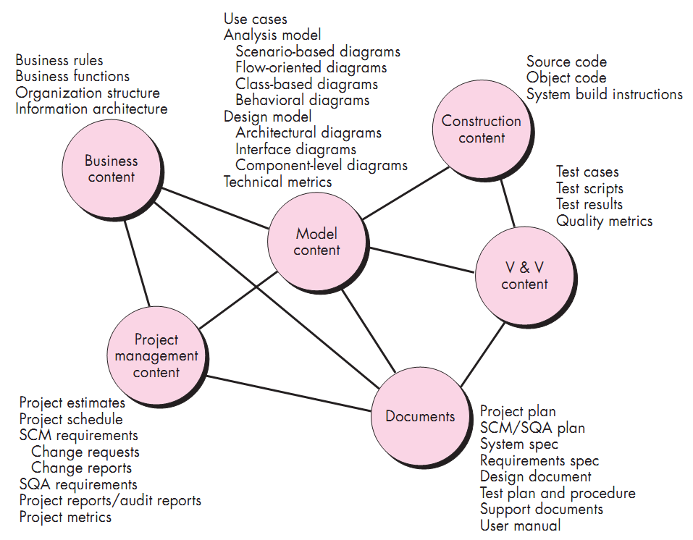
Content of SCM repository
Slide-4
MMH

Slide 5
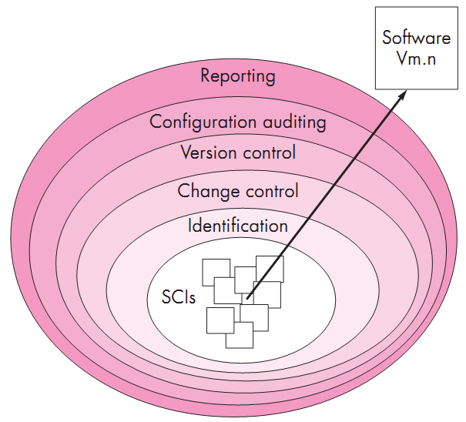
SCM layers
Slide-5
S/w configuration items (SCIs) flow outward through these layers throughout their lifetime
When a new SCI is created, it must be identified, however, if no changes are requested for the SCI, the changer control layer does not apply.
Each SCI created is assigned to a specific version of s/w
A version control captures all changes to all files in the configuration along with the reason for changes and details of who made the changes and when
The record of all these SCI’s (i.e. name, creation date, version, etc.) is maintained for configuration auditing purpose.
MMH

Slide 6
Change control process
Slide-6
Need for change is recognized
Change request from user
Developers Evaluates
Change report is generated
Change control authority decides
If (Request is queued for action)….else (change request is denied)→ user is informed
Assign individuals to configuration objects
“Check out” configuration objects (items)
Make the change ( in design)
MMH

Slide 7
Change control process
Slide-7
Establish a baseline for testing
Perform quality assurance and testing activities (regression testing)
Promote changes for inclusion in next release (revision)
Rebuild appropriate version of software
Review the change to all configuration
Include changes in new version
Distribute the new version
MMH

Slide 8
references
Slide - 8
R.S. Pressman & Associates, Inc. (2010). Software Engineering: A Practitioner’s Approach.
Kelly, J. C., Sherif, J. S., & Hops, J. (1992). An analysis of defect densities found during software inspections. Journal of Systems and Software, 17(2), 111-117.
Bhandari, I., Halliday, M. J., Chaar, J., Chillarege, R., Jones, K., Atkinson, J. S., & Yonezawa, M. (1994). In-process improvement through defect data interpretation. IBM Systems Journal, 33(1), 182-214.

